Slide 1
We will be recording in line with our privacy policy, which you can find on our website
Welcome to the Thriving Lives toolkit webinar series Session 3: Case Study Showcase
All delegates are muted
Please introduce yourself in the chat
If you have a toolkit account, please log in
https://www.scipalliance.org/thriving-lives-toolkit
Notes:
Remind that we will be recording

Slide 2
TODAY’S SESSION
Clare Scherer MBE - Naval Children's Charity, Chief Executive Officer
Matt Blyton - Project Lead
Kerry Newham – Armed Forces Covenant Fund Trust, Grants Manager
Notes:
Leadership from Cwmclydack Primary School will be discussing their effective support strategies for Service children, demonstrating how meaningful approaches can be implemented even with small numbers.
Charmian Hickman, CEO of the Armed Forces Education Trust, has joined us to share information about the individual and collective grants available to schools.

Slide 3
Naval Children's Charity CEO, Clare Scherer MBE
Notes:
Leadership from Cwmclydack Primary School will be discussing their effective support strategies for Service children, demonstrating how meaningful approaches can be implemented even with small numbers.
Charmian Hickman, CEO of the Armed Forces Education Trust, has joined us to share information about the individual and collective grants available to schools.

Slide 4
Case Study Project
Aim: To help schools take a more rigorous approach to the Thriving Lives Toolkit self-assessment by creating a searchable bank of case studies and guidance where school staff can assess their progress by learning from others well-evidenced examples.
The bank of case studies will:
Highlight good practice
Provide ideas of how to enhance support

Slide 5
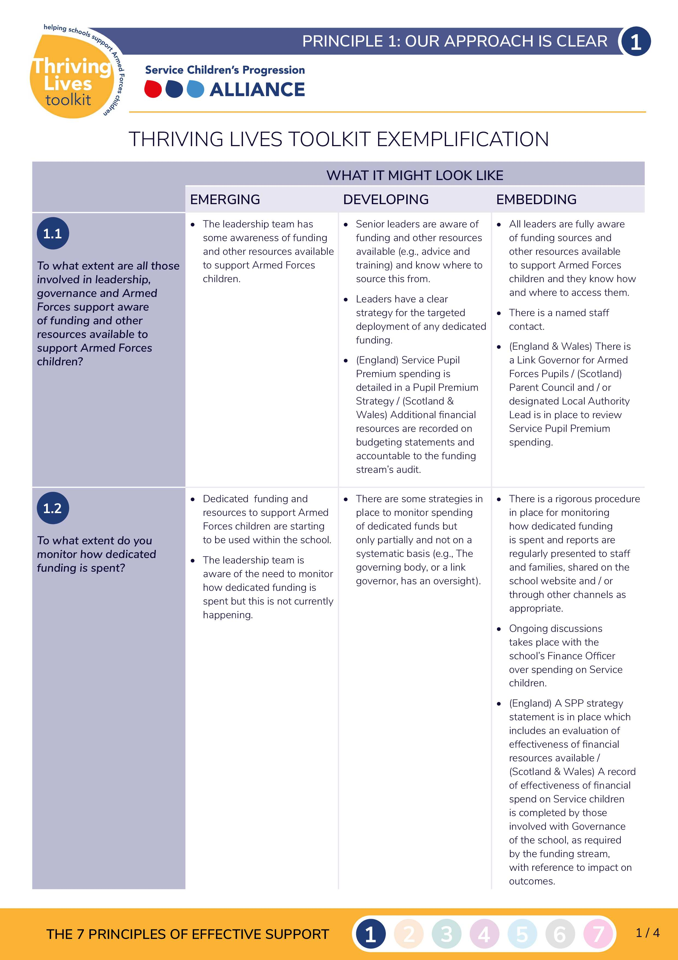
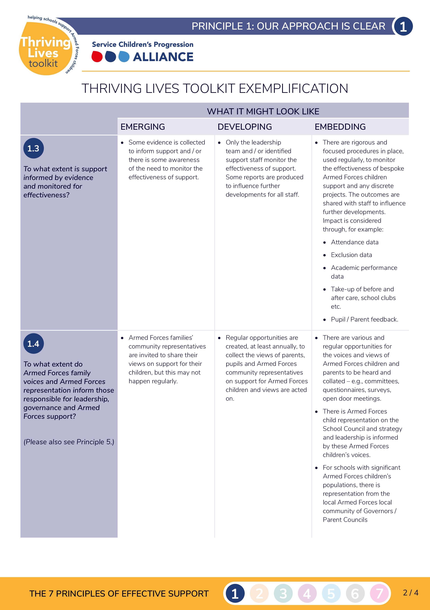
Examples of Resources

Slide 6
Examples of Resources

Slide 7
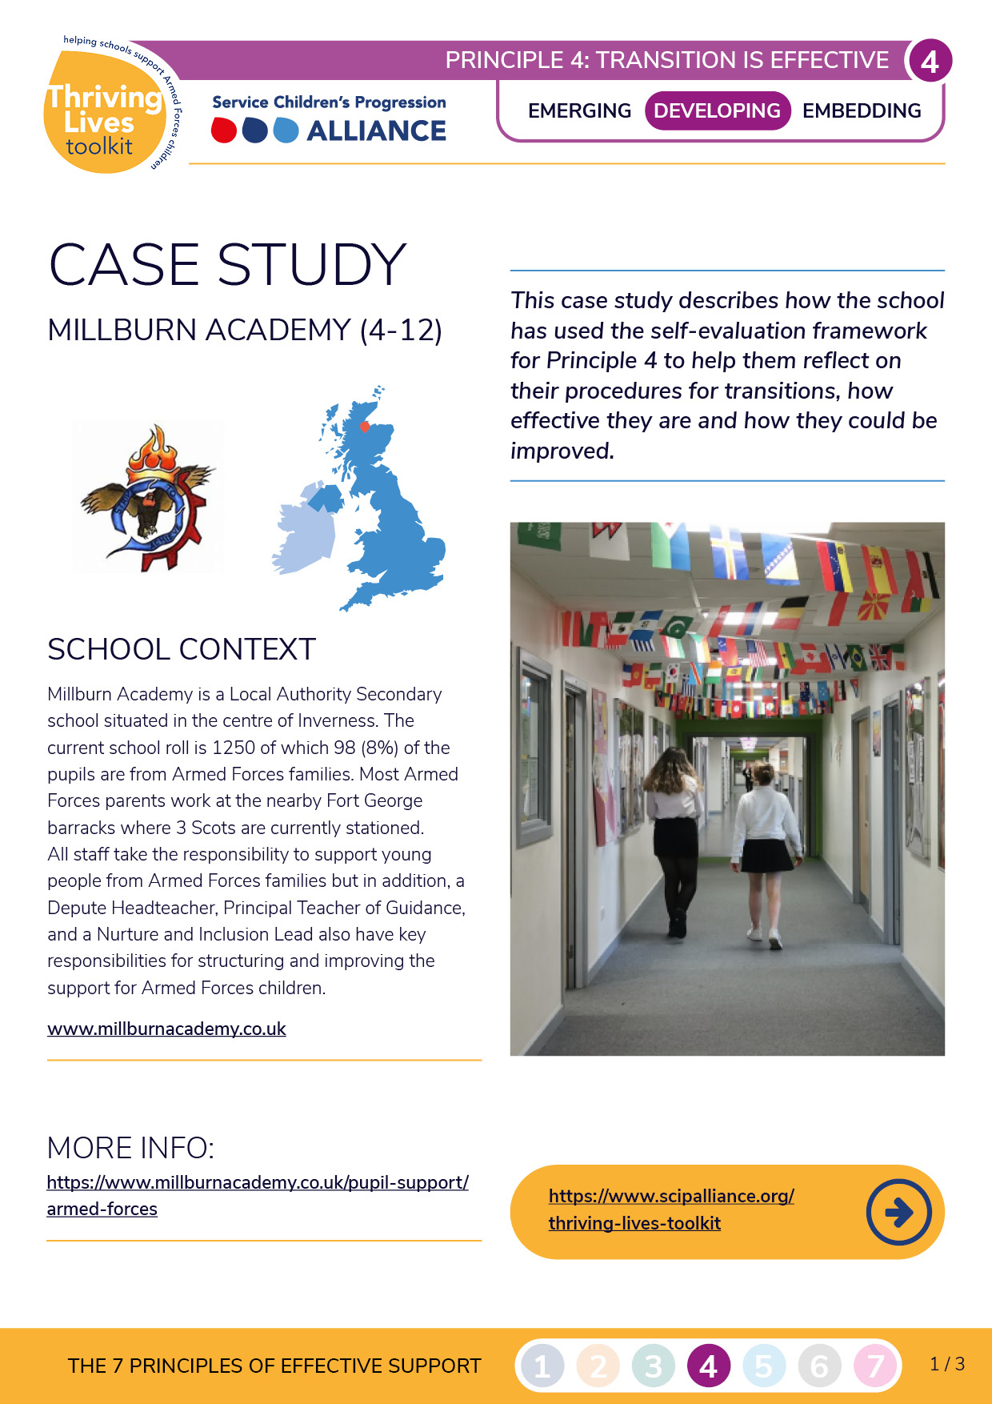
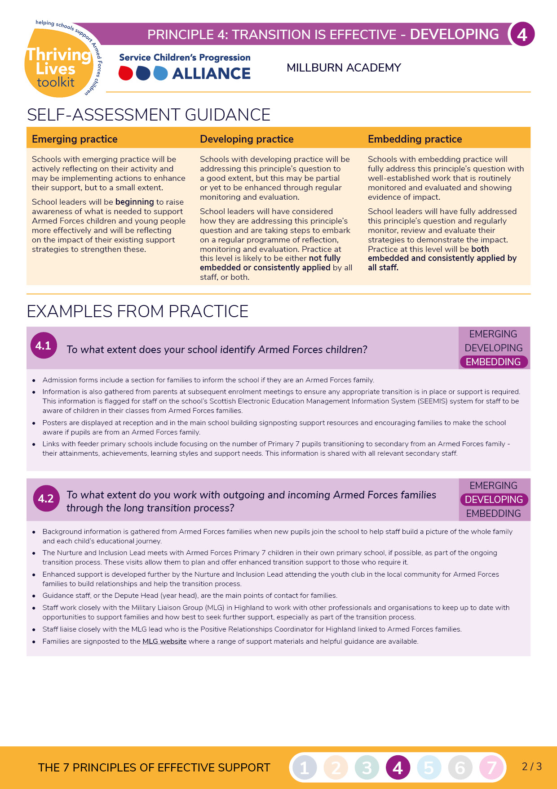
Case Study Format
Principle
Self Assessment
Educational Phase
Context
Website Link
Summary
Guidance
Examples from practice
Leadership quote

Slide 8
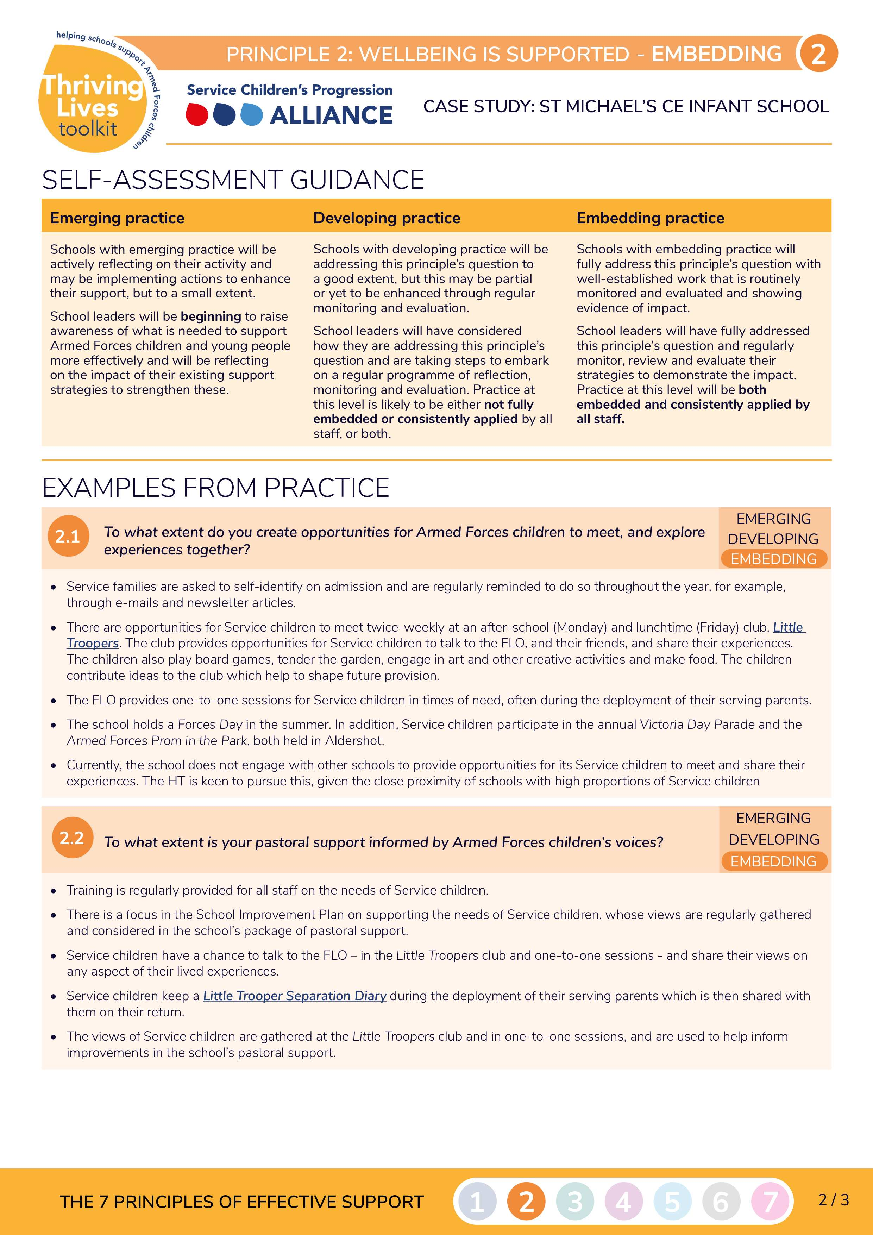
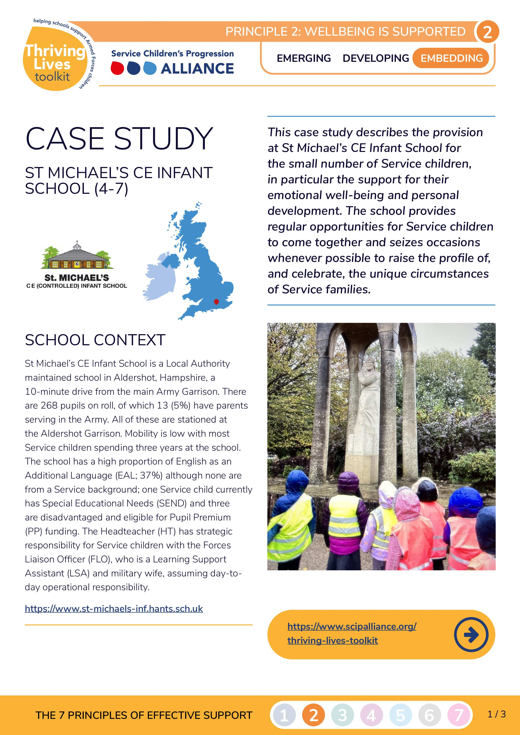
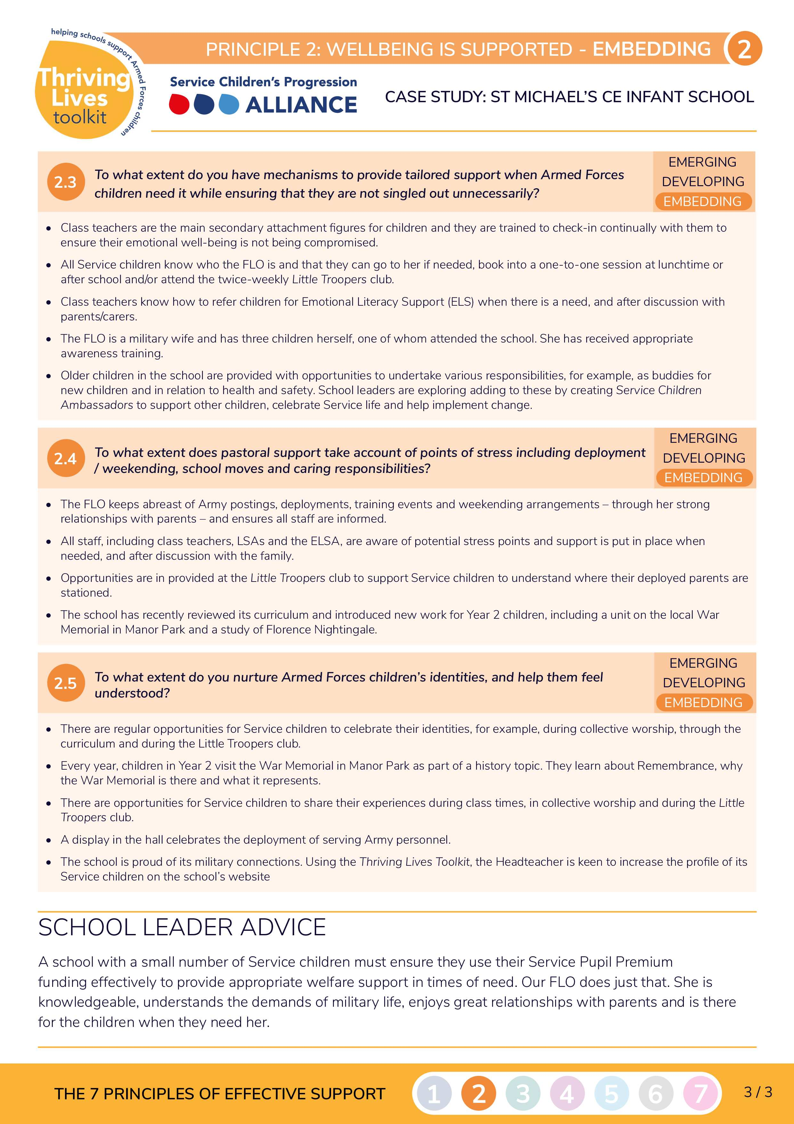

Slide 9
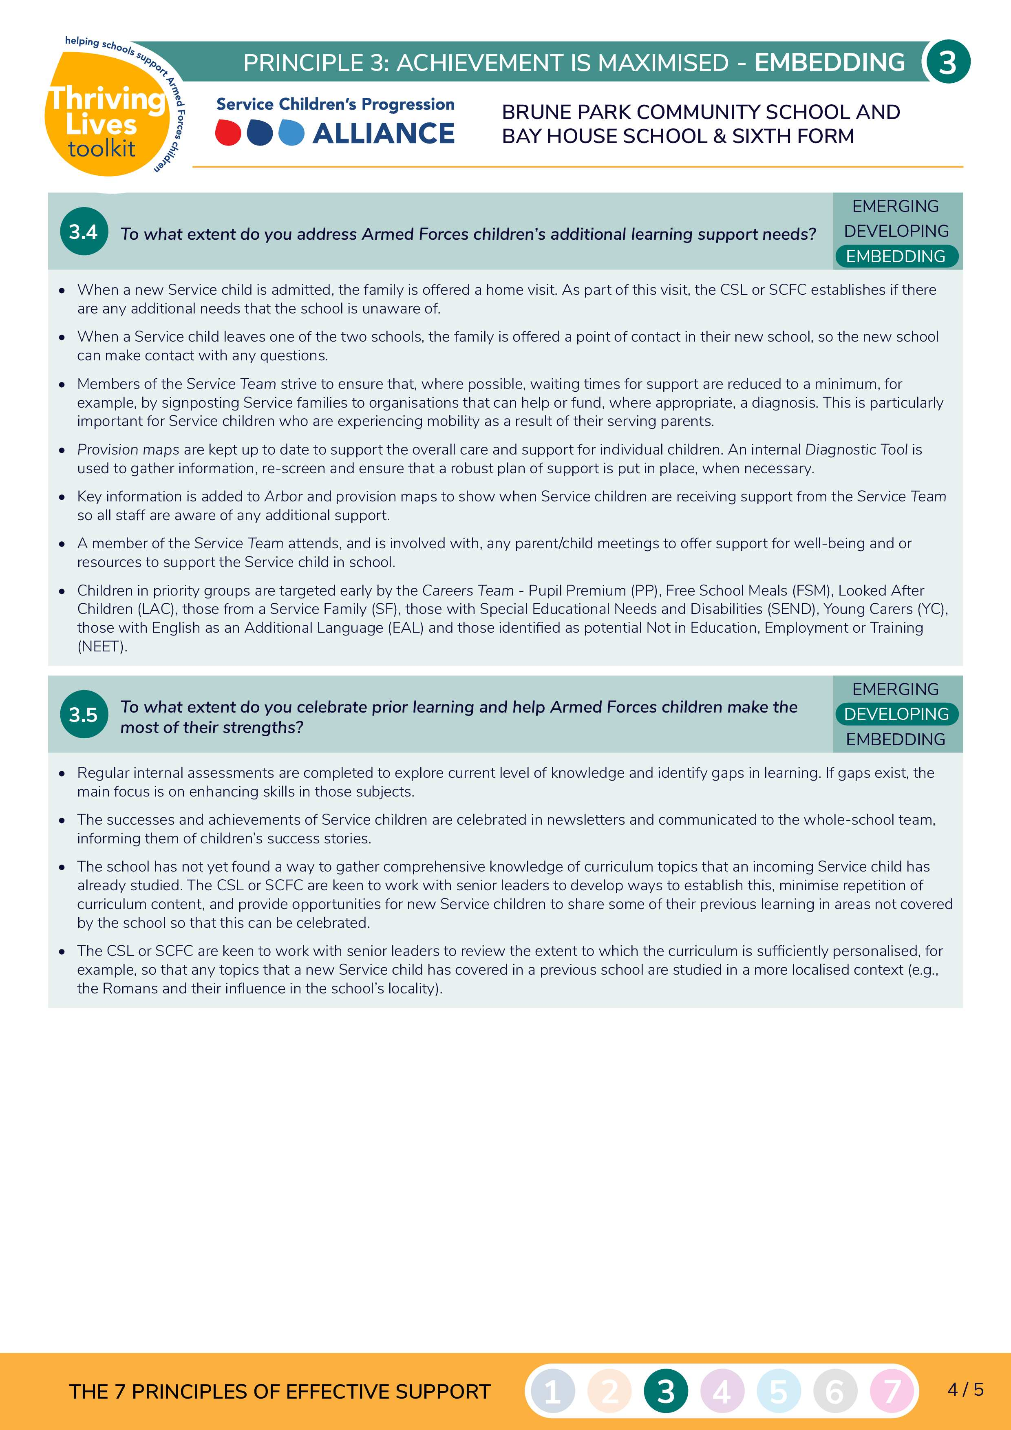
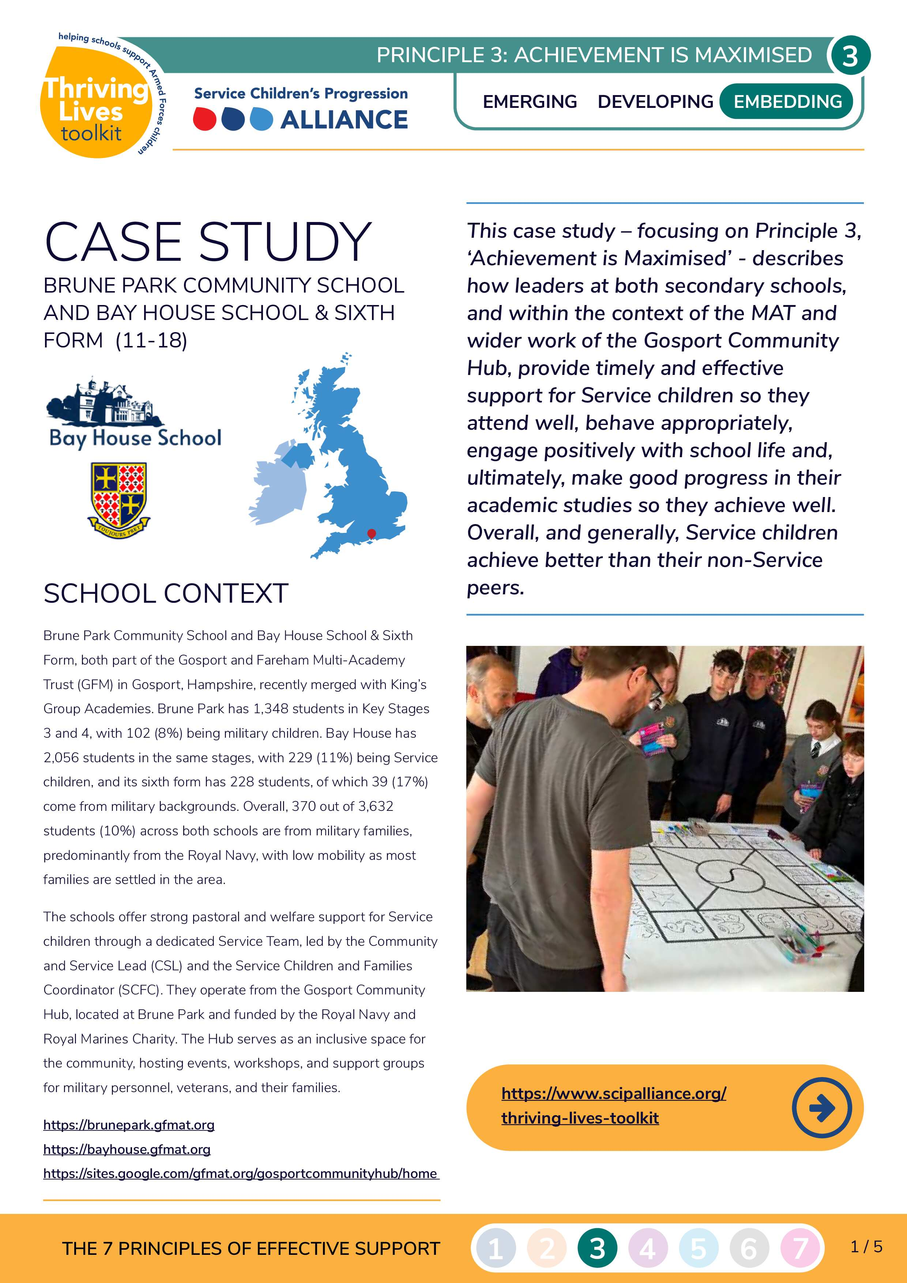
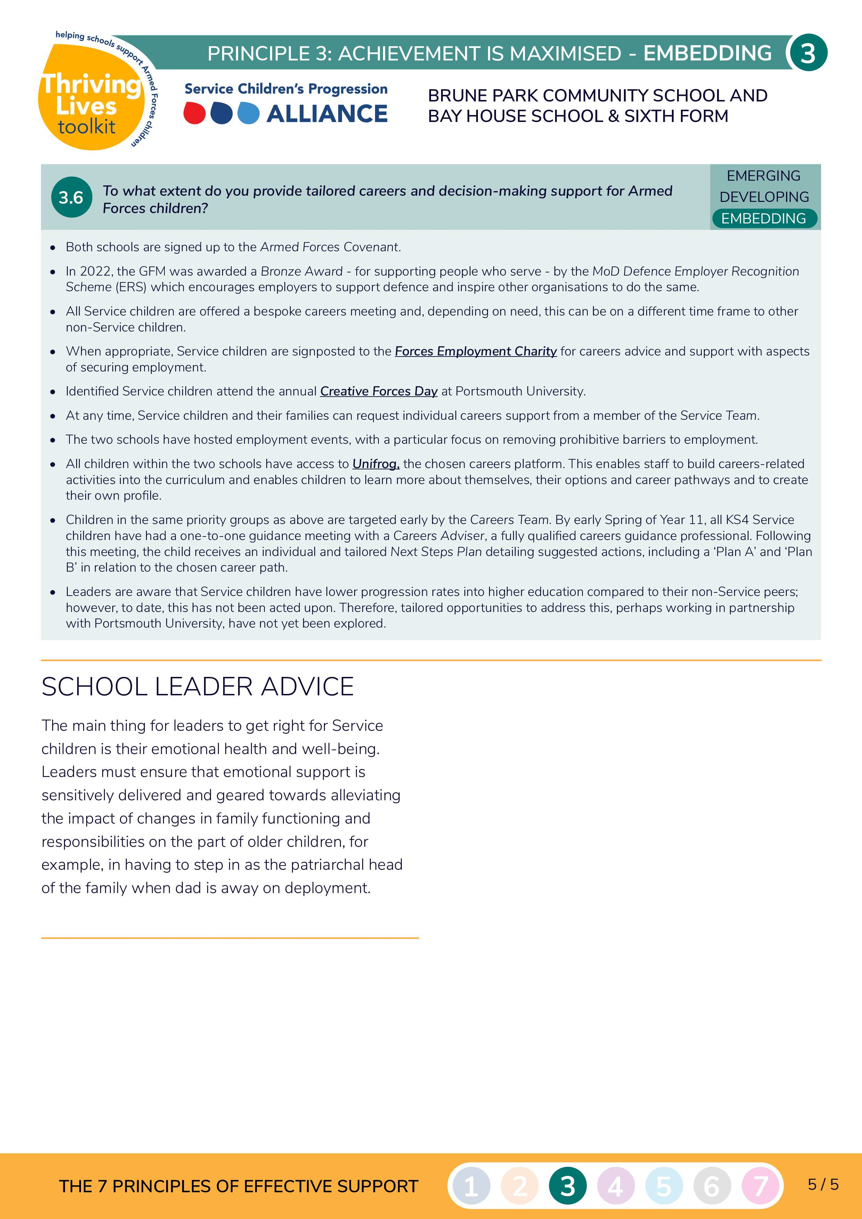
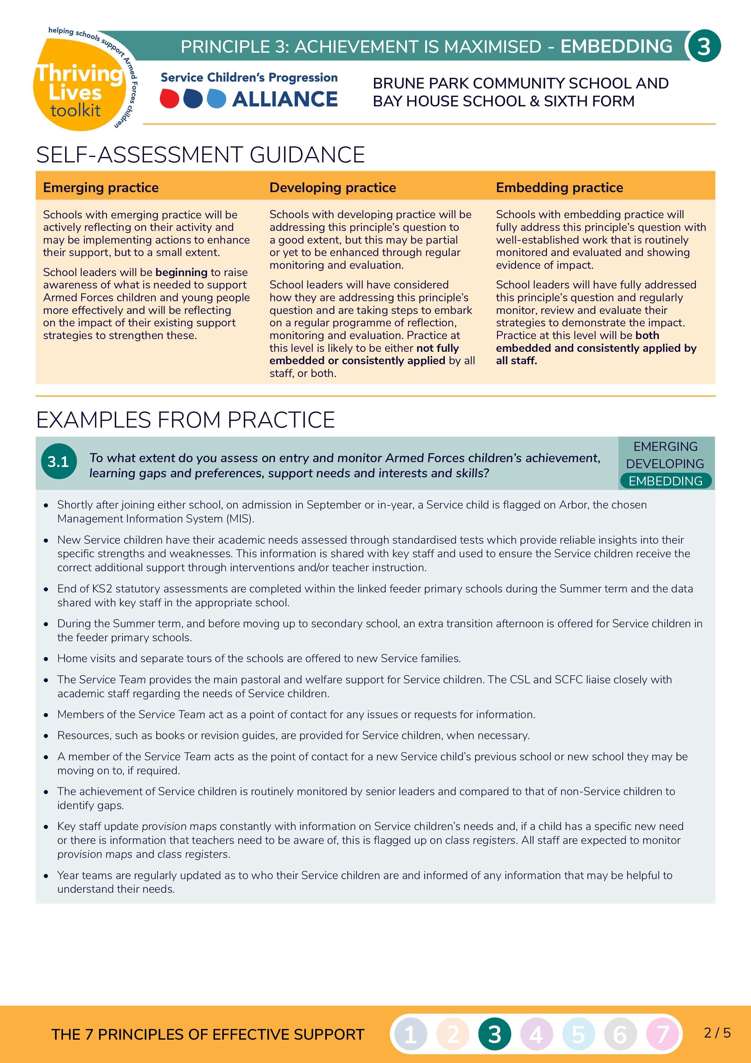
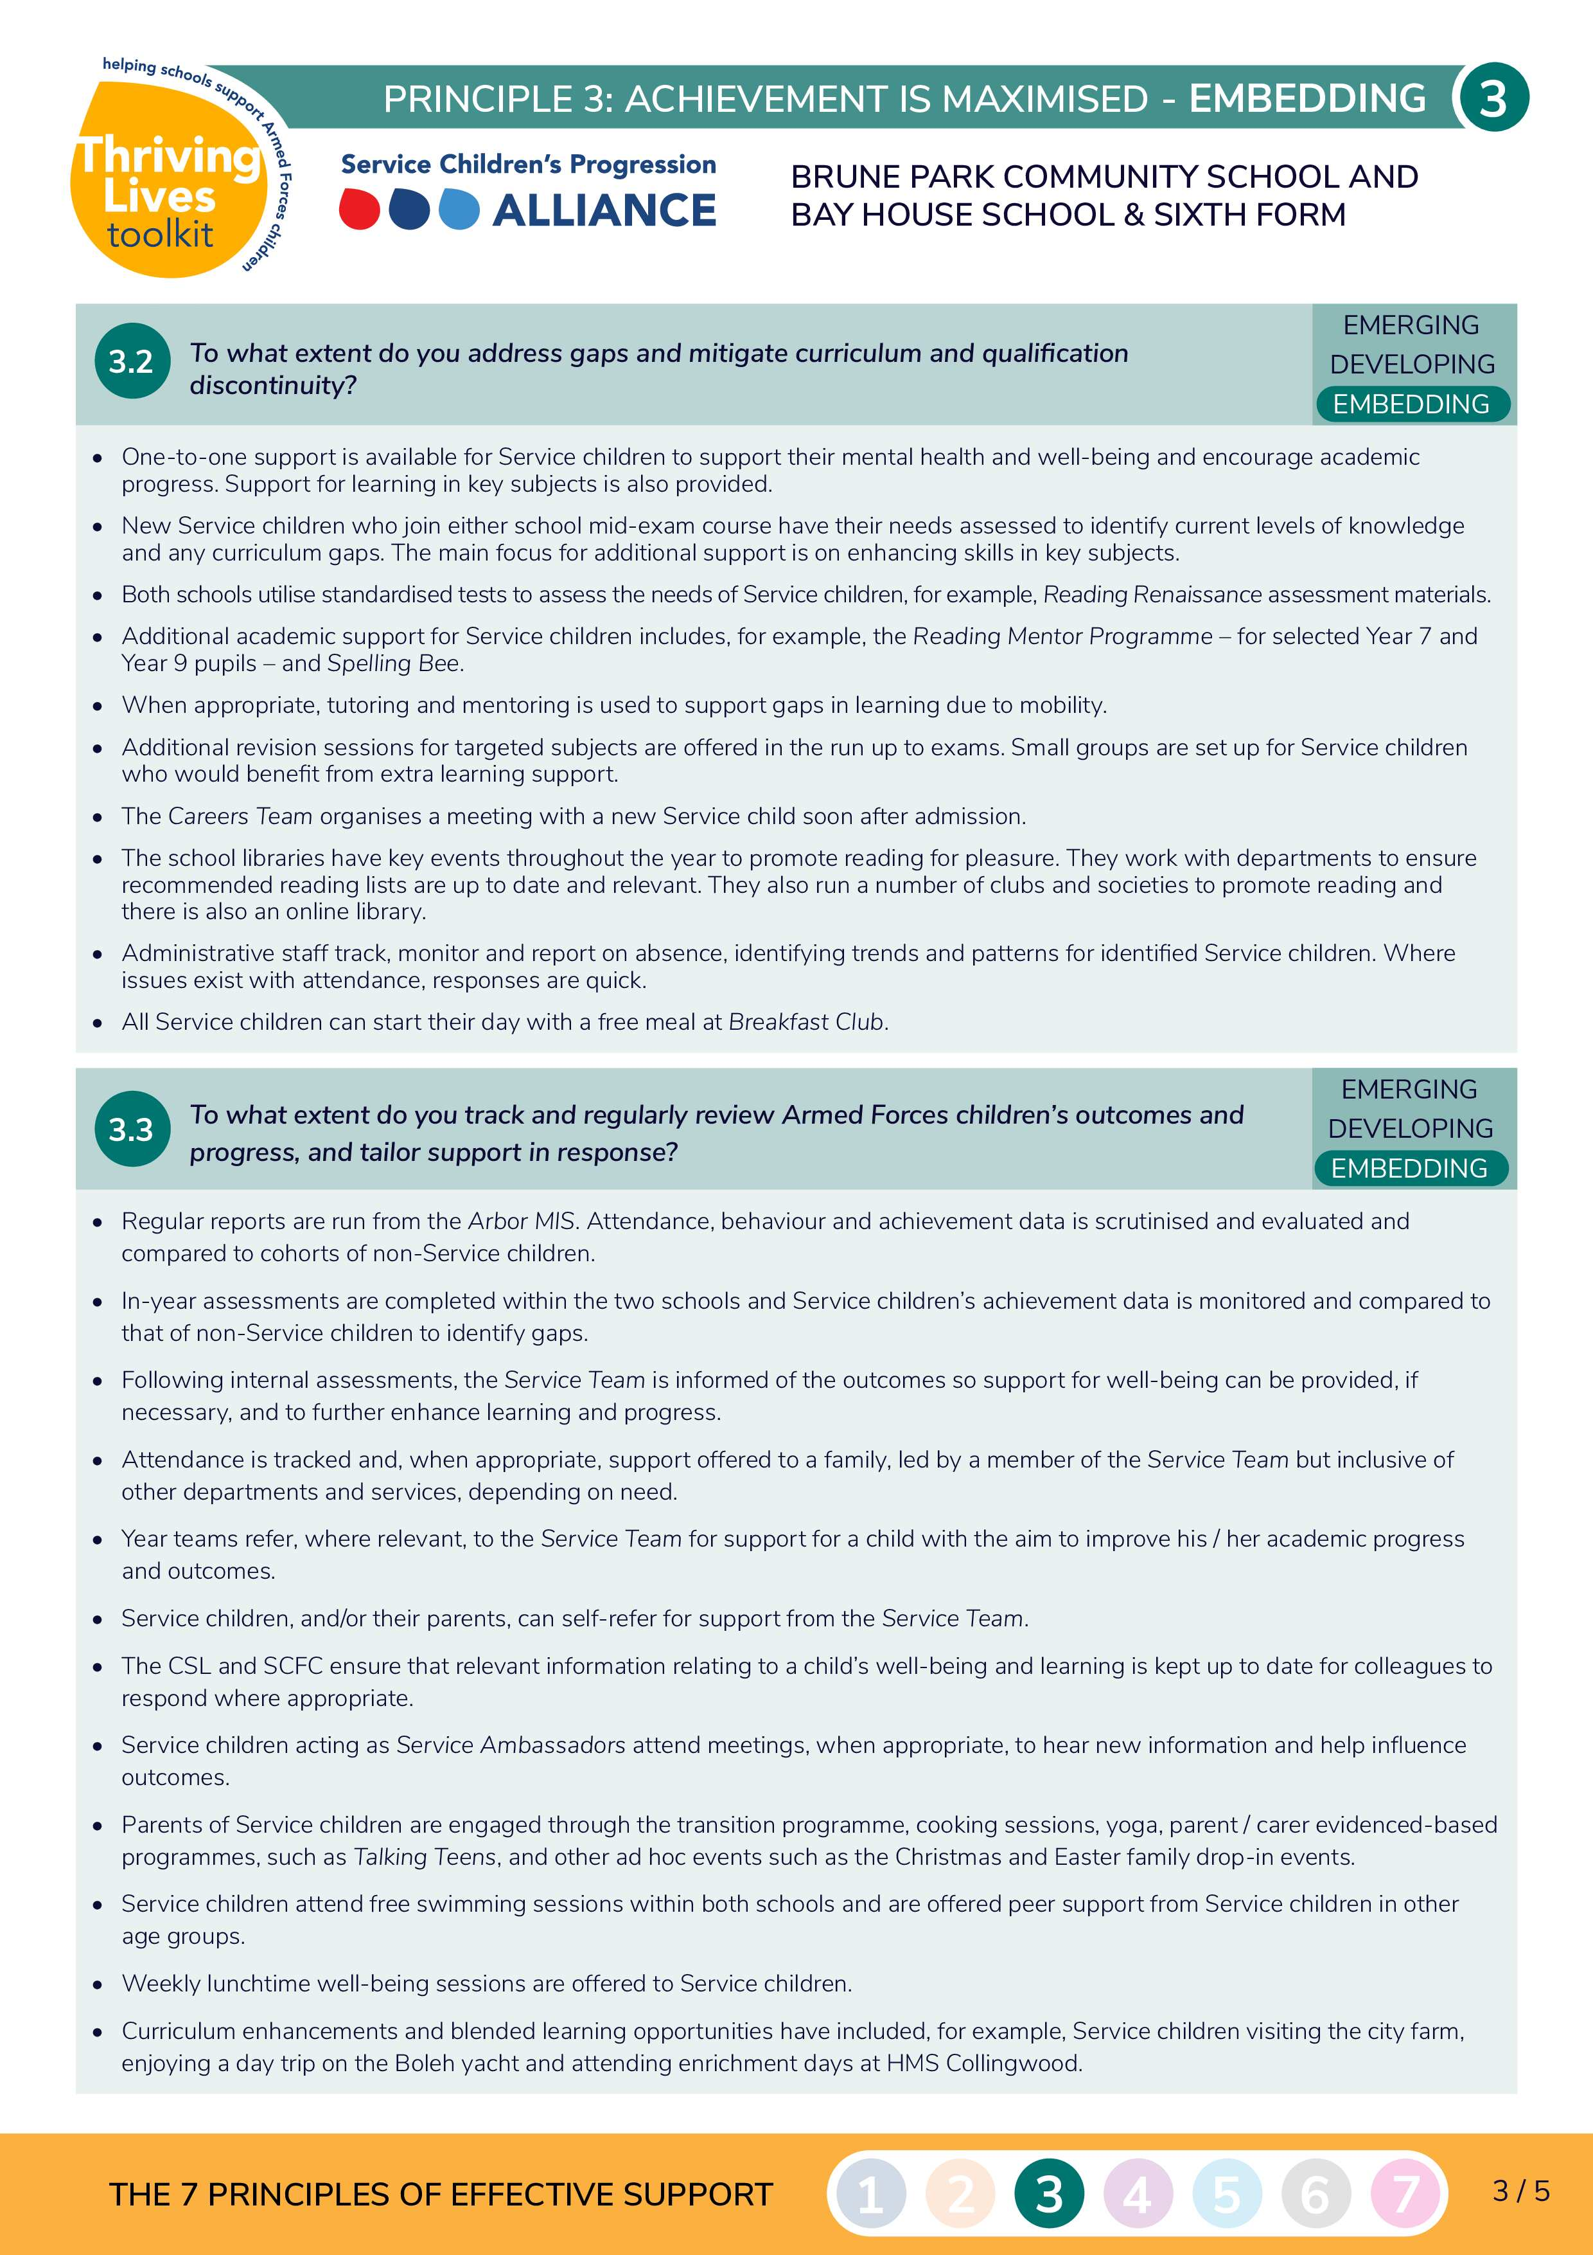
Case Study Examples

Slide 10
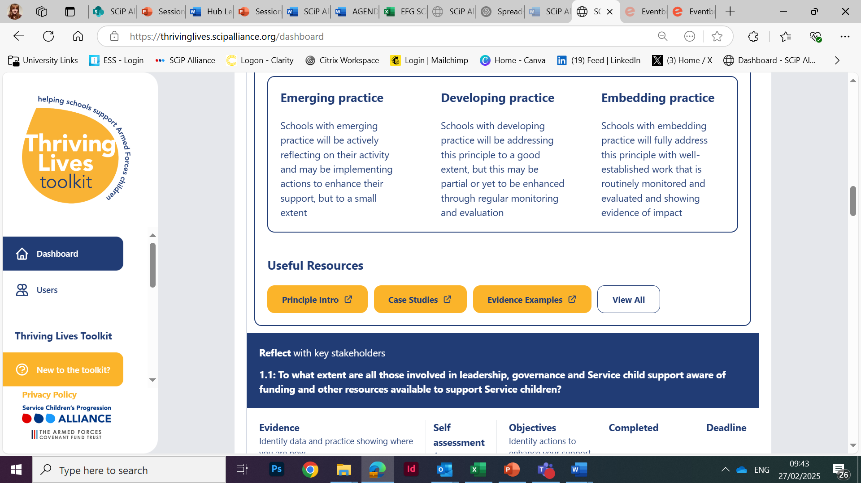
Toolkit Navigation

Slide 11
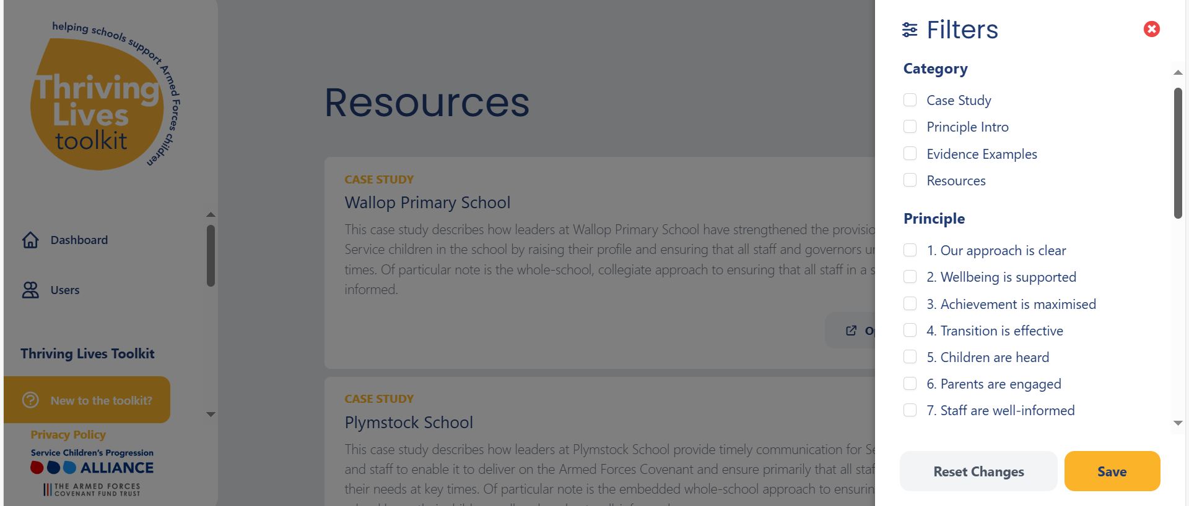
Toolkit Navigation

Slide 12
THE SERVICE PUPILS' SUPPORT PROGRAMME
PART OF THE ARMED FORCES FAMILIES FUND
2025/26

Slide 13
Why are we running this programme?
Following the launch of the UK Armed Forces Families Strategy in January 2022, the MOD created a dedicated fund, ‘The Armed Forces Families Fund’ (AF3). This programme sits within the AF3. The MOD has partnered with the Armed Forces Covenant Fund Trust to administer the AF3.

Slide 14
Aim of programme
To support service pupils along their educational pathway, and to reach their full potential.
Who can apply?
Who should your project benefit?
What’s available?
Maintained schools Academy schools
Free schools Sixth form colleges
Further education colleges Multi-academy trusts
Local authorities.
Children aged 4-18 of currently serving armed forces personnel. Service refers to regular forces and FTRS.
Grants between £5,000 and £150,000 towards a project lasting up to 2 years

Slide 15
Projects should look to address one or more of these four outcomes:
Closing the academic gap in attainment between service and non-service pupils.
Address the needs for service pupils with SEN/D, ASN,ALN
Address the impact of the mobility/deployment and separation on service pupils education
Low numbers of service pupils

Slide 16
Project timeline
Application deadline(s)
Decisions
30 April 25
June 25
Email: info@covenantfund.org.uk

Slide 17
Thank you
Thank you for attending our online webinar. We appreciate your participation and hope you found it valuable.
To help us improve future sessions, please take a moment to complete the evaluation form.
Your feedback is greatly appreciated.

